Slide 1
High School Database
Pooja Pawara
CSCI 226
12/5/2013

Slide 2
Overview:
Created a working Database
Sample Data in Database
Queries
GPA calculator in Python
Scheduler in Python
GUI app in Python

Slide 3
High School Database
This is a Database designed to store the student records.
This database application contains student personal data, the department they are in, the classes they take, the grades they score and the schedule of their classes.

Slide 4
Use of the Database:
To store all the student information.
To check grades of individual students.
It can also be used by the scheduler application to schedule classes for individual students.

Slide 5
ER Diagram:
Name
Contact Info
ID
Year
ID
Name
Advisor
Student
Belongs to
Department
Advises
Name
Takes
Belongs to
Faculty
Contact
Grade
Has
High School
Works at
Classes
Name
Units
name
address
type
Are
Sid
Scheduled
cname

Slide 6
create table high_school(hname varchar(30) primary key, address varchar(40), phone int(10), web_link varchar(20));
create table department(did varchar(2) primary key, advisor varchar(20), room_no int(4), foreign key(advisor) references faculty(fname));
create table classes(cname varchar(30) primary key, ctype varchar(10), units int(4), instructor varchar(20), dependency varchar(30) null, foreign key(dependency) references classes(cname), foreign key(instructor) references faculty(fname));
create table student(sid int(4) primary key, fname varchar(10), lname varchar(10), middle_initial varchar(2), mother varchar(20), dob date, city varchar(20), state varchar(2), country varchar(3), street varchar(25), zip int(5), phone double, gender varchar(7), joining_date date null, grad_date date null, gpa double null, did varchar(2) null, foreign key(did) references department(did));
create table stud_class(sid int(4), cname varchar(30), grade varchar(2), primary key(sid, cname), foreign key(sid) references student(sid), foreign key(cname) references classes(cname));
create table faculty(fname varchar(25) primary key, address varchar(40), phone double, email varchar(30), room_no int(4));create table scheduled(sid int(4), cname varchar(30), primary key(sid,cname), foreign key(sid) references student(sid), foreign key(cname) references classes(cname));
create table timing(weekday varchar(10), period int, hour_from float, hour_to float, primary key(weekday, period));create table class_timing(class varchar(10) primary key, period int);

Slide 7
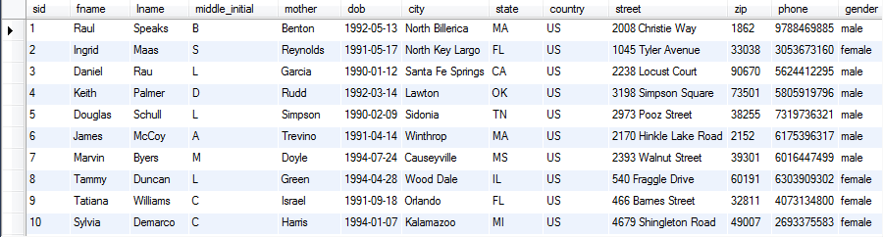
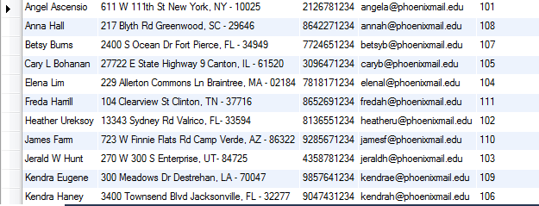
Student and Faculty

Slide 8
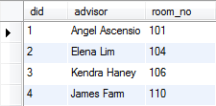
High School and Department

Slide 9
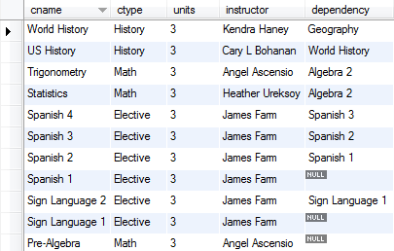
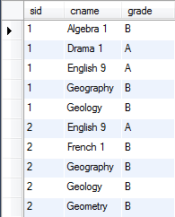
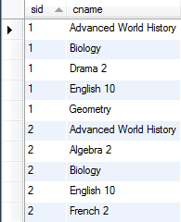
Classes, Classes taken, Scheduled classes

Slide 10
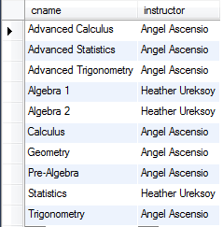
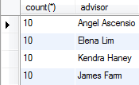
Queries:
select count(*), department.advisor from student join department on student.did=department.did group by student.did;
select cname, instructor from classes where ctype LIKE "%Math%";

Slide 11
Scheduler Application:
Coding in Python
This application will be used to schedule classes for each student depending on the core classes they need to take, the classes they have completed and the electives they choose.
It will also check for dependency issues in classes.
The Data generated will be displayed on the GUI app.

Slide 12
Technology:
MySQL 5.6 – Database
Python 2.7 – Scheduler, GPA calculator
Tkinter Lib – GUI

Slide 13
Thank you..

